Slide 1

Long-Term Gas Planning Proceeding Webinar Series
Building Decarbonization Coalition Presents:

Slide 2














































































































































OUR MEMBERS

Slide 3
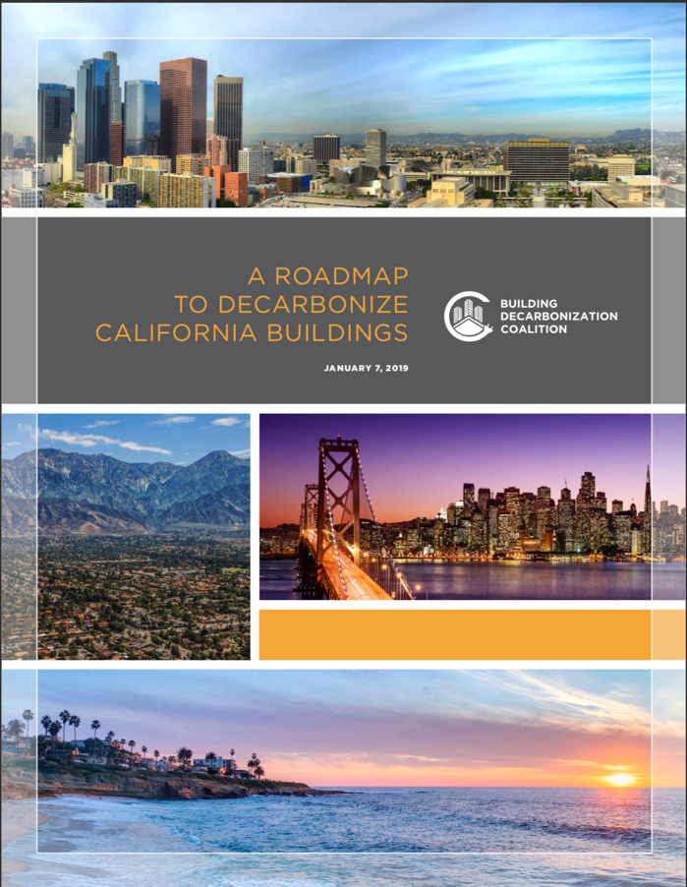
Figure 1: Decarbonization Targets Within the Building Sector
 | Residential | Commercial
New Buildings | 2025: Zero Emissions Building Code | 2028: Zero Emissions Building Code
Retrofits | % GHG reduction below 1990 levels from the overall building stock: 2025: 20% GHG reductions from building sector 2030: 40% GHG reductions from building sector 2045: 100% GHG reductions from building sector
Increase the share of high efficiency heat pumps for space heating from 5% of sales in 2018, to 50% in 2025 and 100 % in 2030. Increase the share of high efficiency heat pumps for water heating from 1% of sales in 2018, to 50% in 2025 and 100 % in 2030.

Slide 4
Roadmap Goals
Goal 1: Build customer, builder, contractor and policy-maker awareness and interest in decarbonization.
Goal 2: Ensure that customers receive a good value from adopting building decarbonization measures.
Goal 3: Ensure that building decarbonization provides a better value to builders and contractors than fossil-fuel heating.
Goal 4: Prepare supply-chains and ensure delivery agents are ready to meet rising demand for carbon-free building technologies with a quality product.
Goal 5: Align Policy to meet other goals.

Slide 5
About this webinar series
This BDC Webinar Series will introduce participants to the main issues addressed in the California Public Utilities Commission's long-time gas system planning proceeding (R.20-01-007), and teach best practices in participating in proceeding discussions.
This proceeding is designed help California plan its gas infrastructure needs as it meets its carbon emissions reductions goals.
Seven webinars scheduled from 11 am-12 pm on Wednesdays from October 14 to December 16, 2020

Slide 6
Coming gas proceeding webinars
Managing Ratepayers Impacts from Stranded Costs and Other Electrification Effects
  Dec. 9 – Register
  Speaker: Mark Toney and Marcel Hawiger, The Utility Reform Network
Supporting Gas Workers in a Just Transition to a Decarbonized Future
  Dec. 16 – Register
  Speaker: Rachael Koss, Adams Broadwell Johnson
Details of other webinars in this series are at https://bit.ly/BDCGasWebinars (case sensitive)

Slide 7
Webinar Logistics
Everyone is muted.
Please ask your questions via chat and we will ask speakers to answer at the end of remarks.
This webinar is being recorded.
Members of the Coalition can access the recording, slide deck, and other resources on the Members-Only website.
  To learn more about membership and how to access this recording and other decarb benefits, visit www.buildingdecarb.org or reach out to Ashleigh at Ashleigh@buildingdecarb.org

Slide 8

Today’s speaker:
Mad Stano, Energy Equity Senior Legal Counsel at The Greenlining Institute
Notes:
Bios:
Mark Kresowik is a Regional Deputy Director for the Sierra Club, with primary responsibility for the Northeast and co-managing national work on equitable building electrification. Through more than fourteen years with the Sierra Club Mark has initiated and led successful campaigns to replace dozens of coal-fired power plants with energy efficiency and clean energy, end mountaintop removal coal mining, electrify transportation and buildings, and transition communities and workers to a more prosperous and sustainable future.
Edward Yim is Energy Policy Advisor for the District of Columbia’s Department of Energy and Environment. In this role, he develops decarbonization and resilience strategies, and advises on issues concerning energy system transition. He performs research and planning, and develops initiatives and projects to help achieve the Department’s deep decarbonization goals. He led the effort to develop the District’s grid modernization roadmap as well as the District’s climate and energy plan, called Clean Energy DC, which formed the basis of the District’s Clean Energy DC Omnibus Amendment Act. Currently he is leading a team developing the District’s Strategic Electrification Roadmap, funded by US DOE. He is also working to develop a Net Zero Energy Neighborhood pilot as well as a solar plus storage residential microgrid pilot. His background includes energy law and architecture, and he is a certified Passive House consultant.
Alice Napolean is a policy analyst focusing on energy efficiency, energy justice, and alternative regulatory mechanisms. She has led work for the U.S. Environmental Protection Agency on quantifying the benefits of clean energy resources, energy efficiency potential, and low income energy efficiency efforts; developed and submitted testimony regarding low-income energy efficiency services in California, New York, Nova Scotia, and South Carolina; provides policy analysis, drafts tesitmony and comments, and provides litigation support on energy efficiency design, planning, administration, and cost-effectiveness in New Jersey and Nova Scotia; provides ongoing expert analysis and support to Natural Resources Defense Council in the New York Reforming the Energy Vision process on matters of benefit-cost analysis, utility performance incentive mechanisms, energy efficiency targets and program design. Ms. Napoleon previously worked at Resource Insight, Inc. where she supported investigations of electric, gas, steam, and water resource issues, primarily in the context of reviews by state utility regulatory commissions.

Slide 9
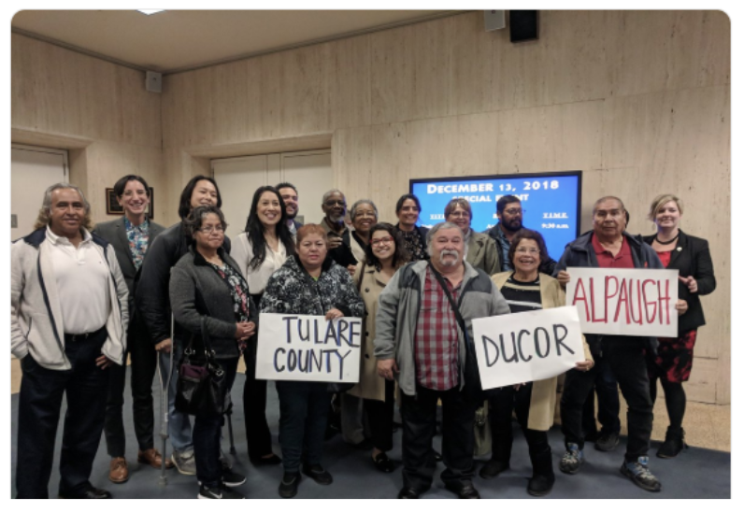



Decarbonization: Pathways to an Equitable Gas Transition in California
December 2, 2020
Mad Stano
mad.stano@greenlining.org

Slide 10

ROAD MAP
EQUITY GROUNDING
WHERE ARE WE STARTING FROM?
EQUITY IMPACTS OF GAS TRANSITION
COMMUNITY-LED SOLUTIONS
WHY → HOW

Slide 11
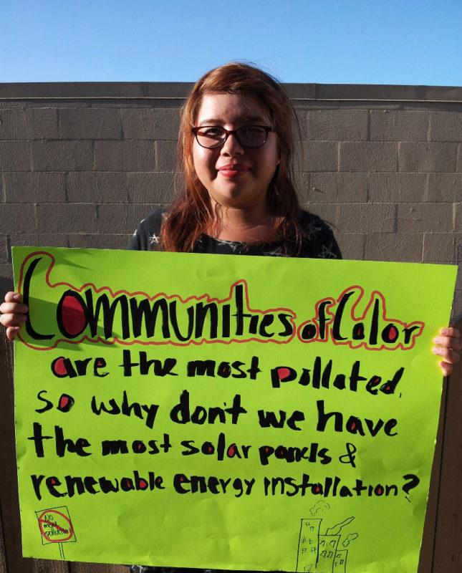
Energy Equity
Notes:
Define energy equity : no false choices between access, safety, affordability, health, labor rights, climate justice, economic justice.
Energy should be affordable, so that no one has to go without.
Energy should be clean, so that no one is harmed by fossil fuel pollution.
Energy should be resilient, so that its there when we need it.
Communities of color must play a lead role in our transition to a clean energy economy—as beneficiaries, as decision-makers, and as the entrepreneurs and workers that will build our clean energy future.

Slide 12

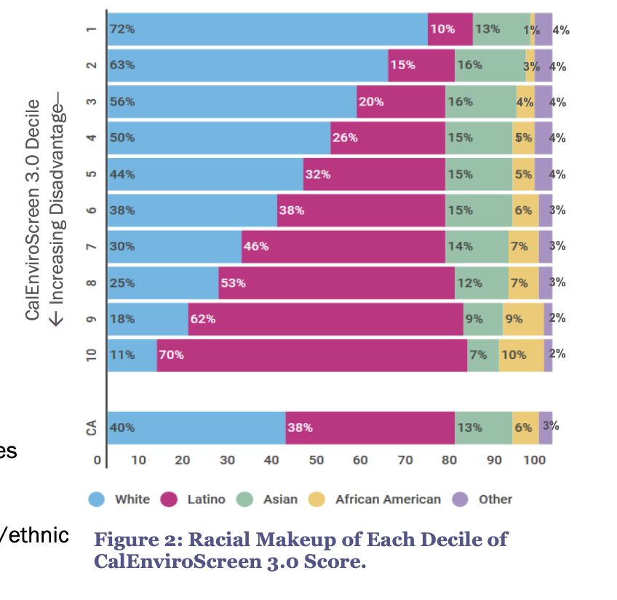
Notes:
-race #1 predictor of environmental burden (even when you account for SES) - natural gas siting, quality of service, affordability - disprorptionate impacts
-Describe CES - 1st version (2012)
-race
-cumulative impacts inc. pollution burden from multiple sources and socioeconomic factors

Slide 13
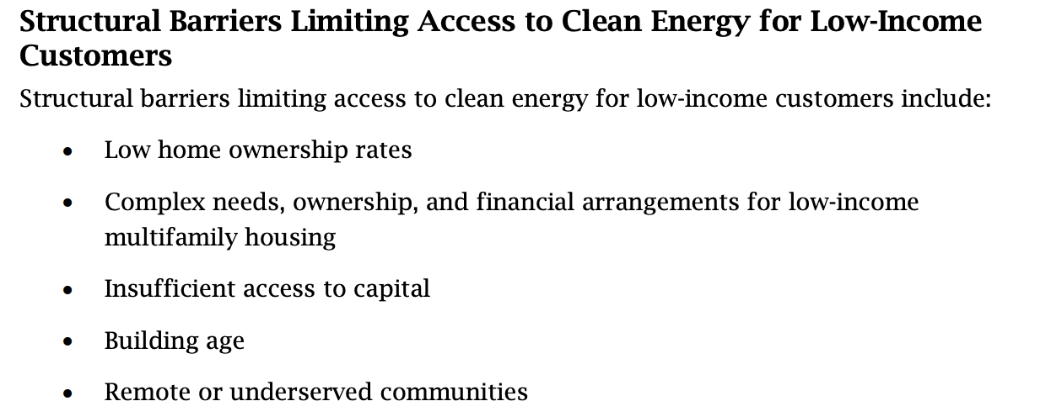
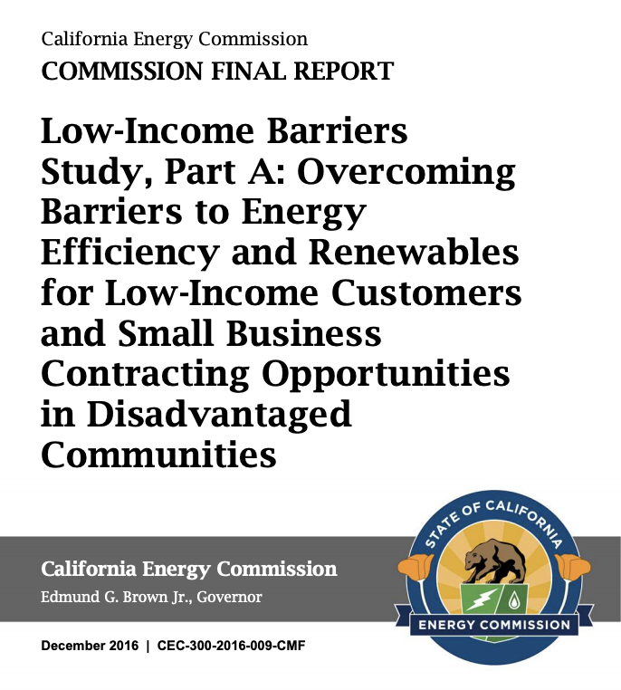
Policy Barriers:
Market Delivery
Program Integration
Data Limitations
Unrecognized Non-Energy Benefits (NEBs)
Additional Burdens:
Energy Burden
Disconnections
Access to Services + Technologies
Notes:
-disproportionate burden from gas system (LI residents pay 3x as much as for energy burden as non-LI residents), coupled with barriers to clean tech + transition technologies
-rooftop solar, net energy metering etc, LI people pay in and don’t benefit.

Slide 14
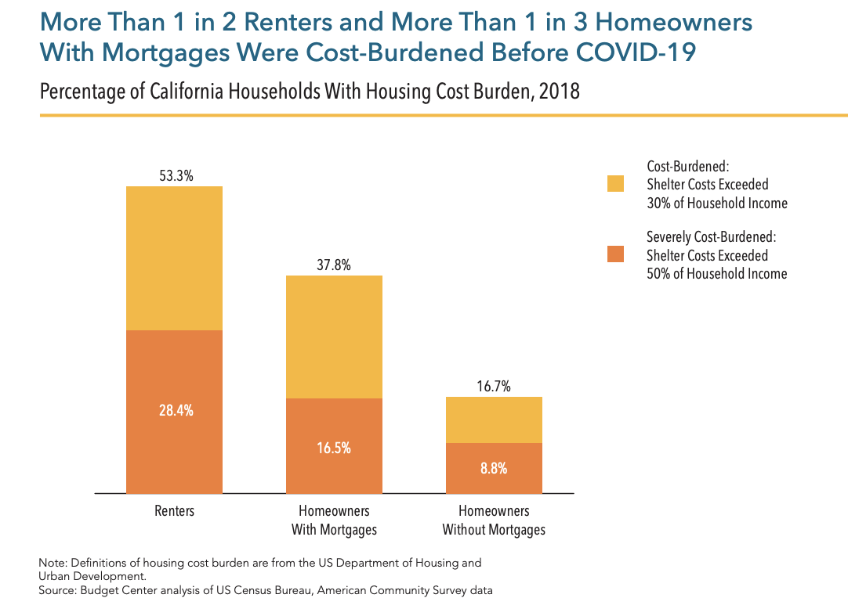
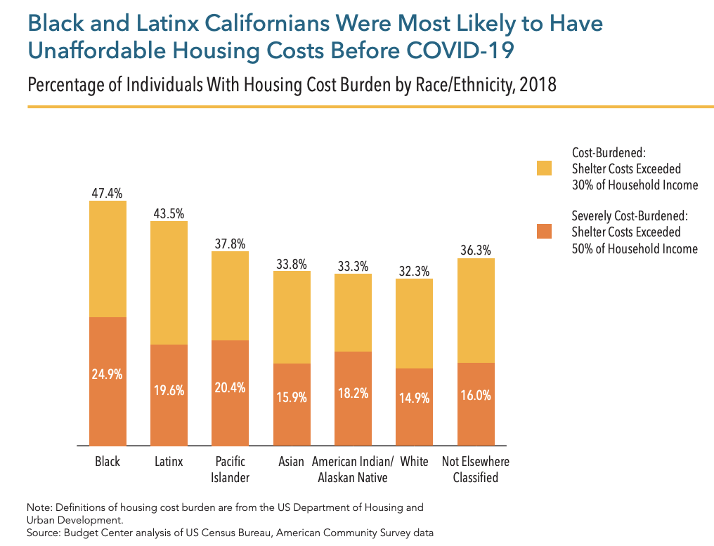
Notes:
-affordability: baseline (household costs include rent/mortgage + utilities): California Budget Center, July 2020 Report
-our starting point is dangerous + damaging: any increase in gas rates is unacceptable for low income people - raise energy insecurity.
-energy burden - low income pay 3 times as much of their percentage of income on energy than wealthier counterparts
-split incentive - unique situation for renters
-wealthier communities leaving the gas system, concern: lower income ratepayers left on the gas system regardless of choice with rising costs.
-additionally barrier: rate structure

Slide 15
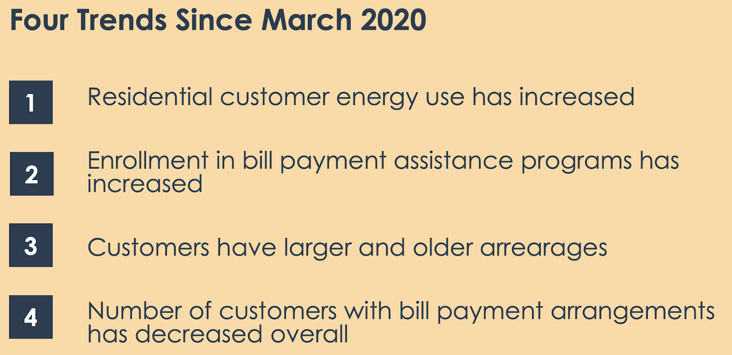
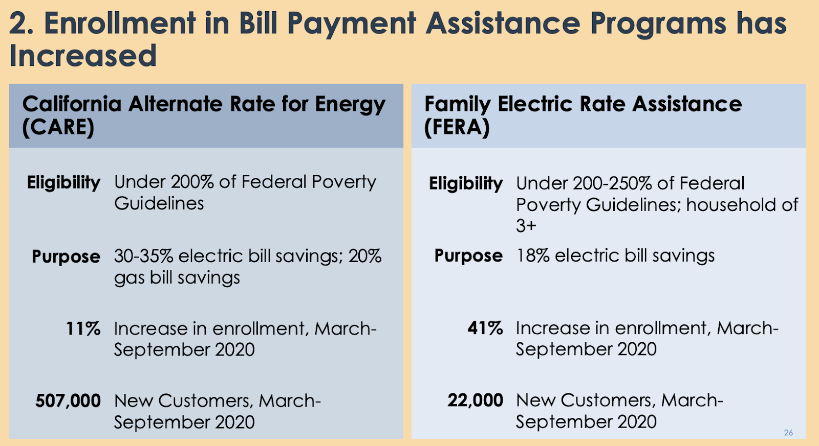
CPUC Workshop on COVID Impacts on Customers in the Energy Sector November 12, 2020

Slide 16
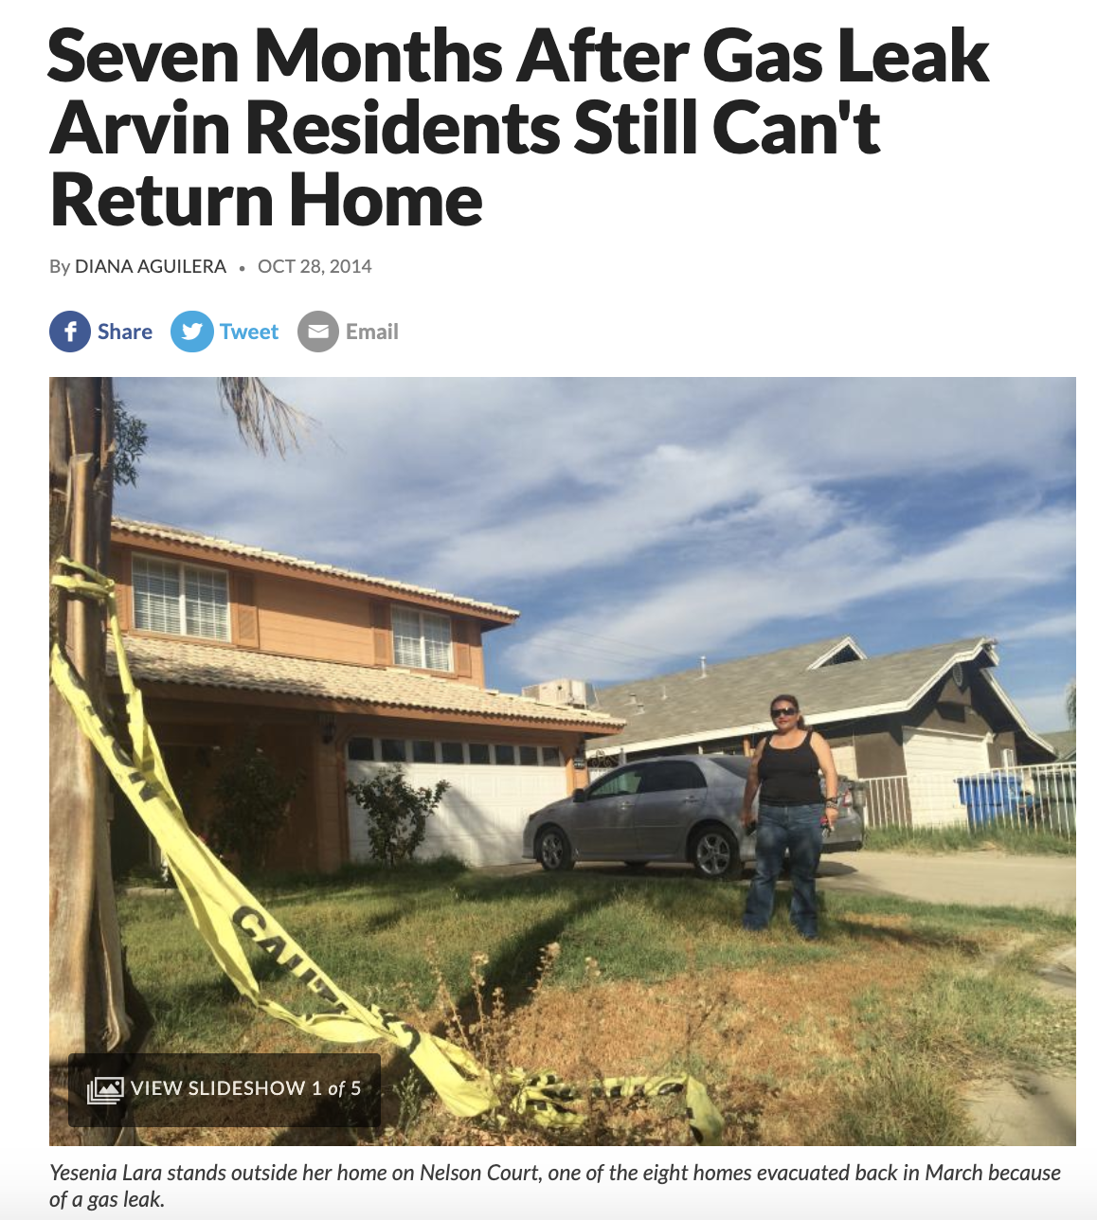
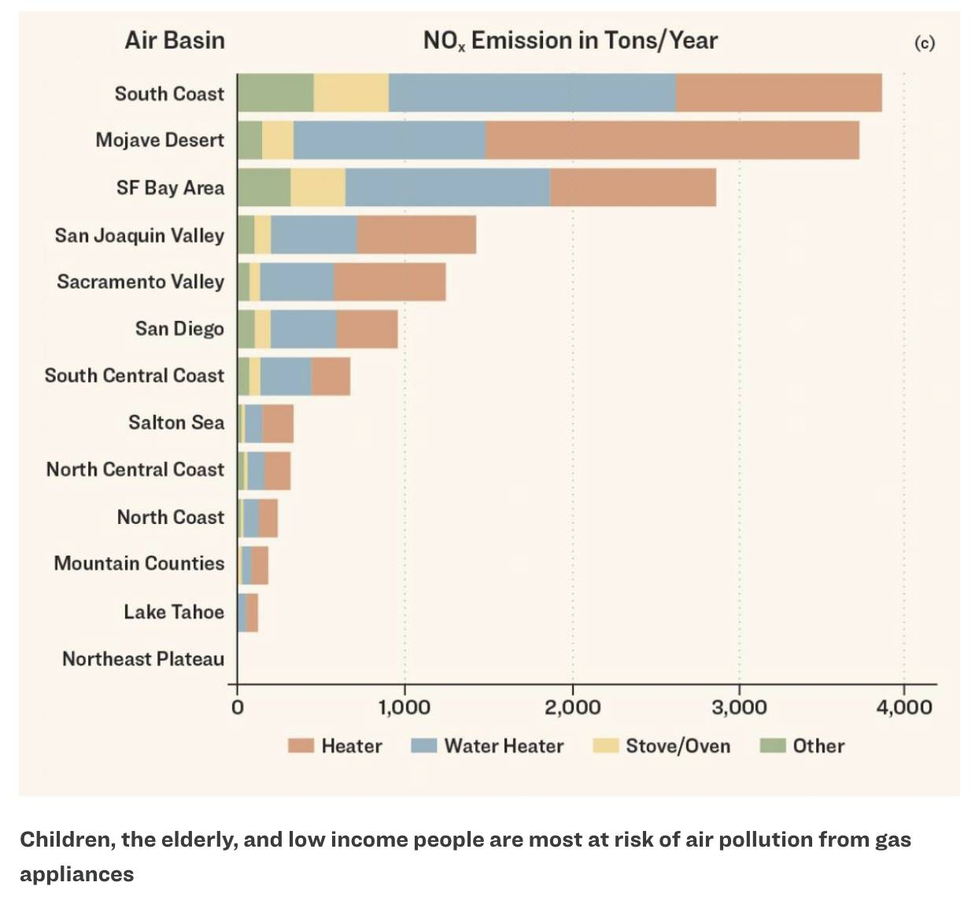
Notes:
-health + safety disproportionate impacts

Slide 17

Vision
Building electrification must focus first and primarily on the goal of improving the health and resilience of the people and all communities must have the opportunity to shape and benefit from building electrification policies.
Notes:
July 2019

Slide 18
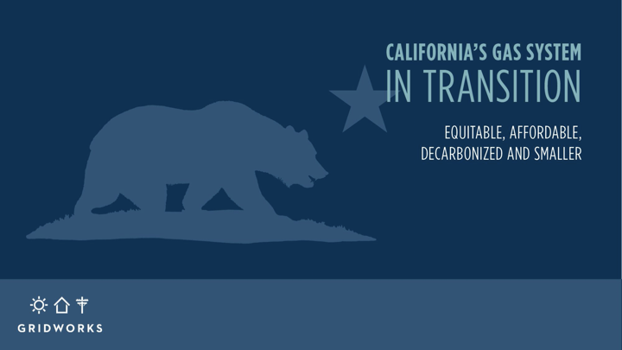
Refresher from Gridworks first round:
CA’s Gas System in Transition (2019)
o Bill protections for low-income people
o Programs & resources to enable electrification
o 1 stop shop for all program offerings
o Barriers Study (low-income electrification)
o Meaningful community engagement
o Ensure Low-income people & DACs are included in the benefit from gas transition
Notes:
-Mad

Slide 19
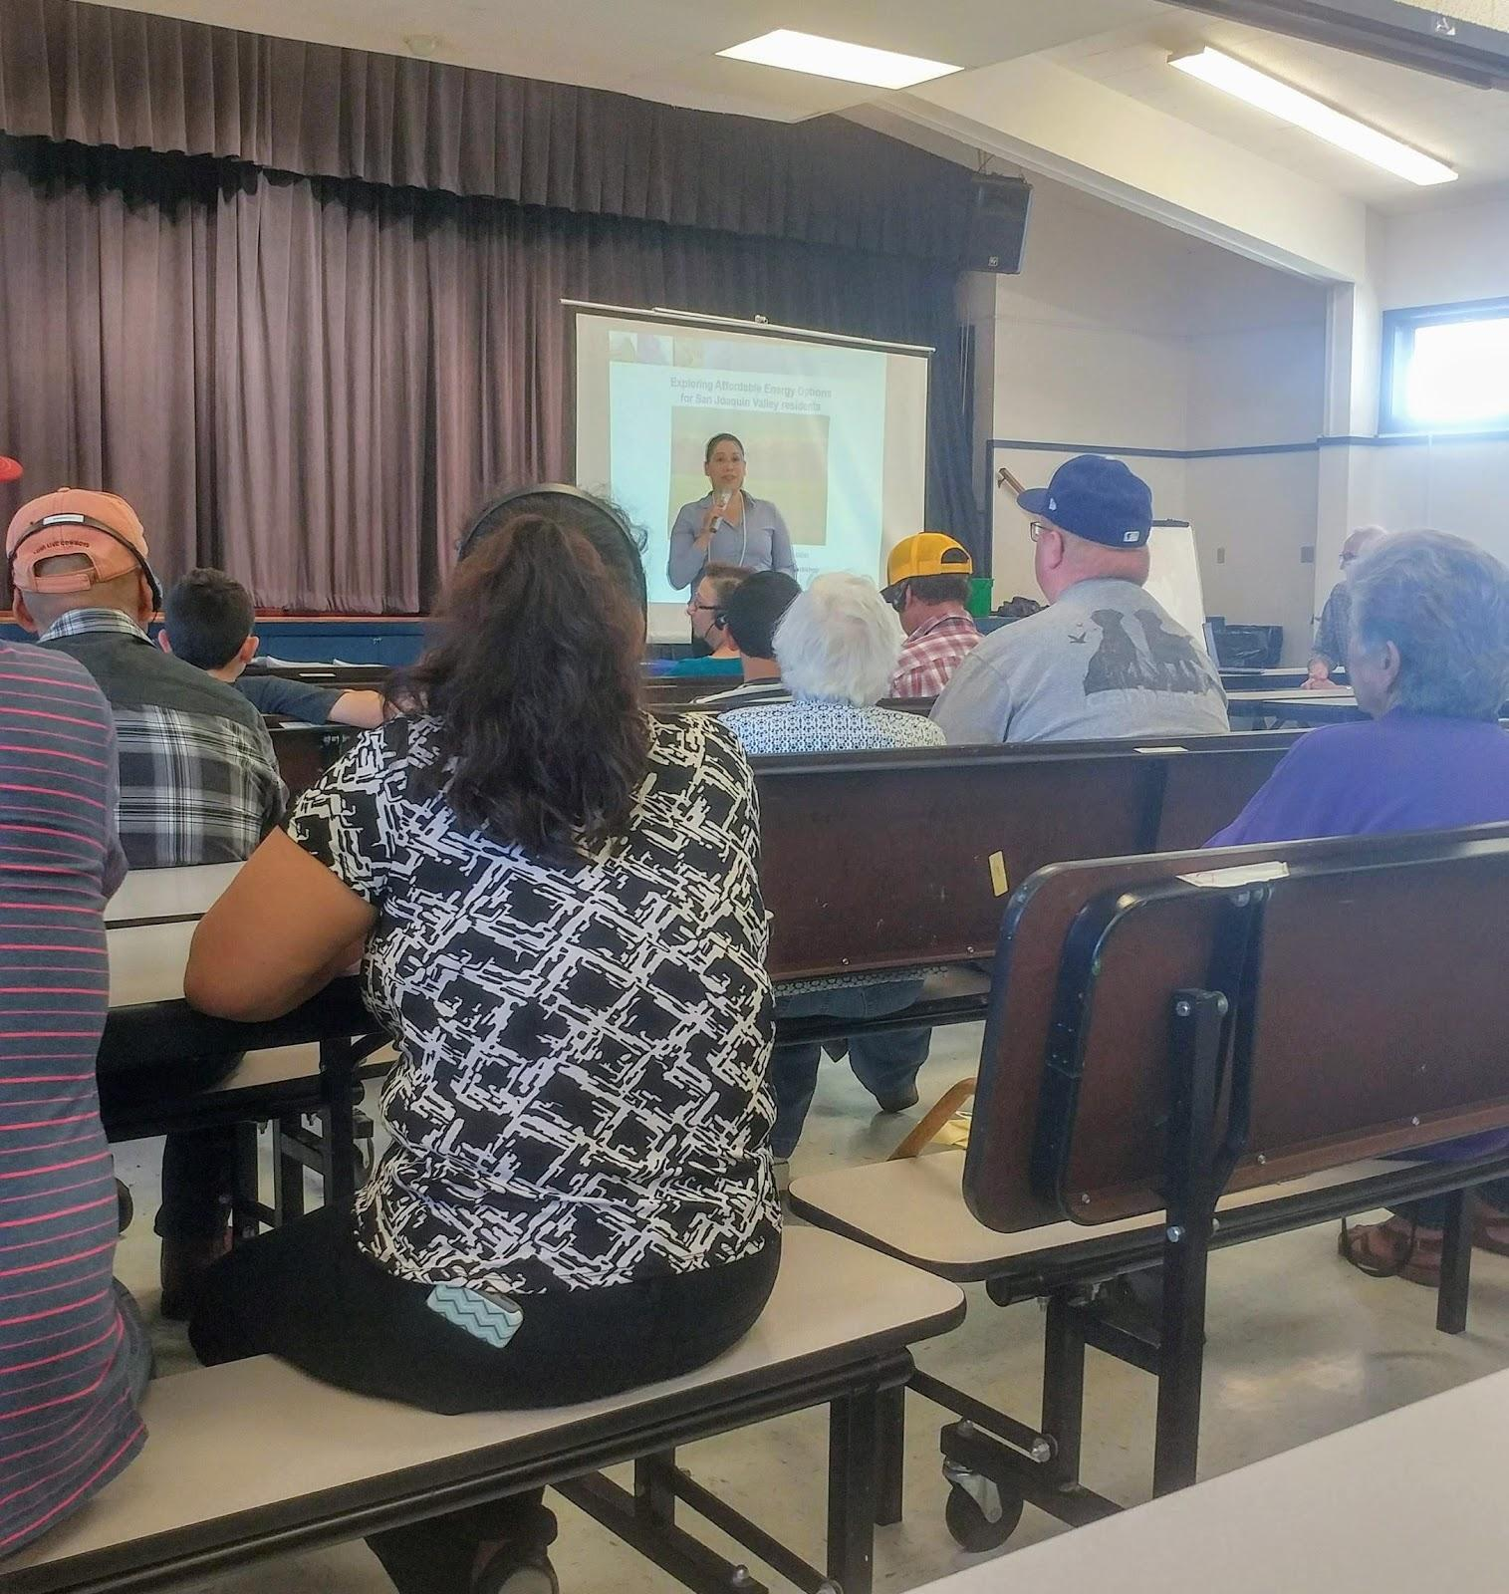
San Joaquin Valley Affordable Energy Pilots - Common Community Elements
Outreach & Education
  Community Energy Navigator
Bill Savings
  Protections - Rebound Effect
  Savings - Restitution
Tenant Protections
Workforce Training/Local Hiring Requirements
Appliance Warranties
Community Data Gathering
Alpaugh, CA - Community Energy Option Assessment Workshop June 2018

Slide 20

Goals for Proceeding -
Corrective, Procedural, Distributive Justice
Minimize potential burdens for disproportionately overburdened low-income communities of color.
  Increased rates + stranded assets.
  Decreased safety of infrastructure.
  Decreased quality of service.
  Increase barriers to accessing beneficial technologies + services.
  Inequitable changes in infrastructure.
  Negative economic impacts on workers and communities.
Maximize potential benefits for disproportionately overburdened low-income communities of color.
  Health/Safety - Household.
  Health/Safety - Community.
  Mitigate Climate Change.
  Increase access to beneficial technologies.
  Decrease energy burdens.
  Support high quality jobs + access.

Slide 21
Key Points - Track 1 - Reliability + Market Standards
Our reliability + market + safety rules must incorporate controlling climate + equity statutes (SB 100, SB 350, local ordinances etc) = plan for MAJOR reduction in throughput.
  Holistic planning approach rooted in equity.
  Customer demand assumptions are 2000 and late.
  Customer demand cannot exceed greenhouse gas emissions reduction requirements.
  Minimize new investments (safety requirement).
  Value of assets = realistic life + use of asset.
  DER exists and we should use! Invest in new and not old!
Consequences for failure to meet minimum design + safety standards ($ utility shareholders, not low-income people).
Cost of stranded assets + rate increases = paid for by parties responsible, not low-income people.
Notes:
-slack capacity, OFO, reliability definition, snowpack standards.

Slide 22

In the FUTURE… Track 2
Assume all gas is off the system by 2050 - no combustion, no false solutions. End date to plan backwards from.
Beneficial pilots especially in low-income/DAC communities. There is so much of the how we can’t answer yet.
Bill protections/bill savings for low-income people!
Make whole the communities that bear a disproportionate burden of the existing gas system, inter alia, by directing the benefits of the transition there.
To the extent externalities exist, responsible parties should pay the cost, not ratepayers generally, especially low-income.
Localized solutions to address regional diversity.
Optimize non-energy benefits of the transition (participant, utility, societal).
Meet our pollution + climate + equity commitments - across agencies.

Slide 23

Thank you!
Mad Stano
mad.stano@greenlining.org
Art: Favianna Rodriguez

Slide 24
Contact
Our Speakers today:
Panama Bartholomy, Building Decarbonization Coalition at panama@buildingdecarb.org
Mad Stano, Greenlining Institute at mad.stano@greenlining.org
Learn more about the series and BDC’s advocacy action plan for the Gas Proceeding
Michelle Vigen Ralston, Common Spark Consulting at michelle@common-spark.com
Learn about membership with the BDC
Ashleigh Spurgeon, Building Decarbonization Coalition at ashleigh@buildingdecarb.org

Slide 25
Join us!
Building Decarbonization Coalition Presents
buildingdecarb.org/join

