Slide 1
How to Electrify Your Home Without Panel Upgrades
Sean Armstrong
Redwood Energy

Slide 2
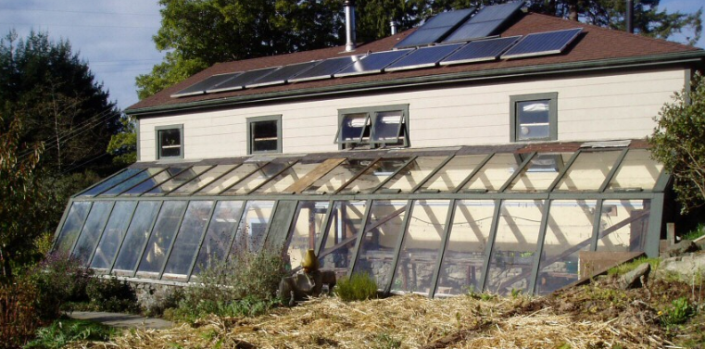
Sean Armstrong Managing Principal at Redwood Energy seanarmstrongpm@gmail.com 707.826.1450
1995-2019 The Campus Center for Appropriate Technology
2002-2005 High School Science Teacher
2005-2011 Affordable Housing Project Manager, Pacific West Communities
2011-Today Redwood Energy’s Managing Principal. ZNE Design and Research.

Slide 3
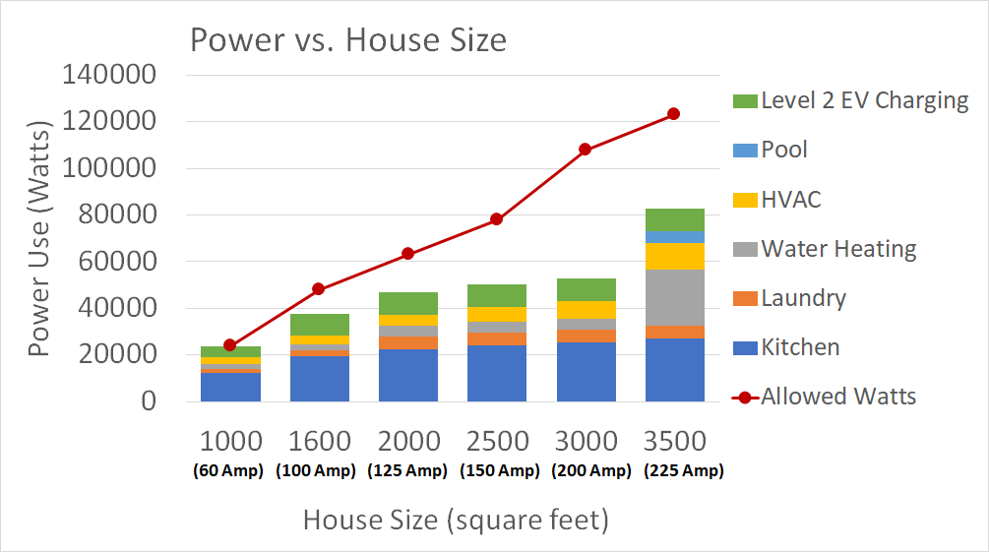
We define the “Watt Diet” as the total power used in a home that determines what panel size the home should use.
The bigger the home, the bigger the electrical panel
Most panels (newer, bigger homes) have enough space for all electric end uses
The focus of this presentation is on smaller, retrofit homes
Total Allowed Watts

Slide 4
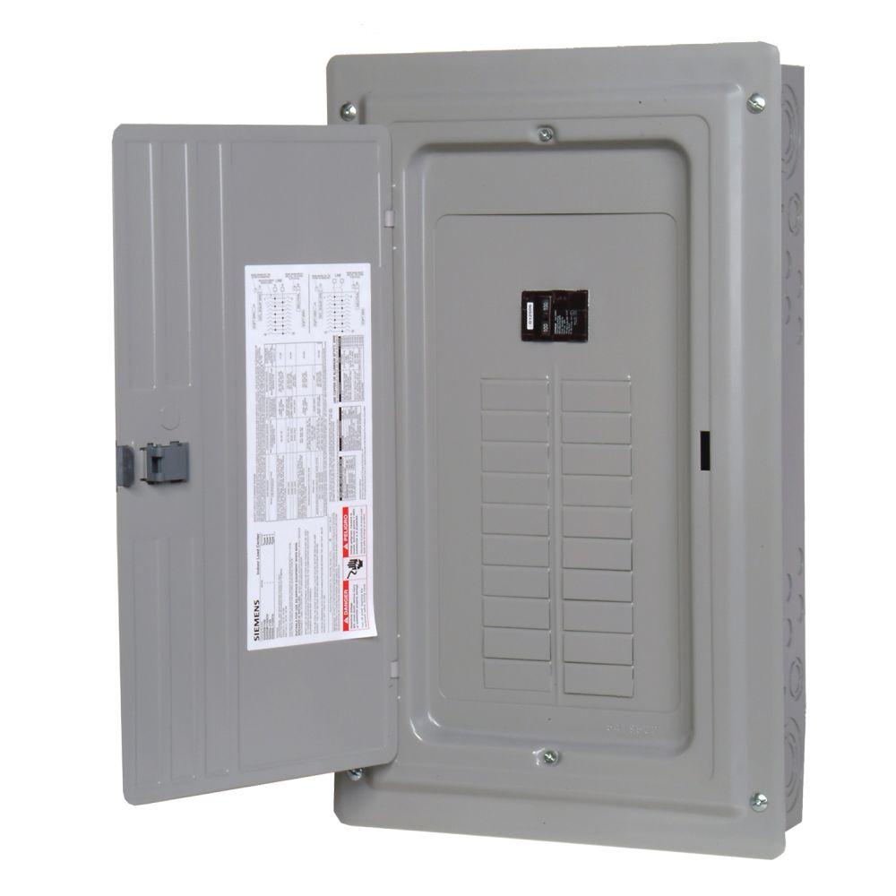
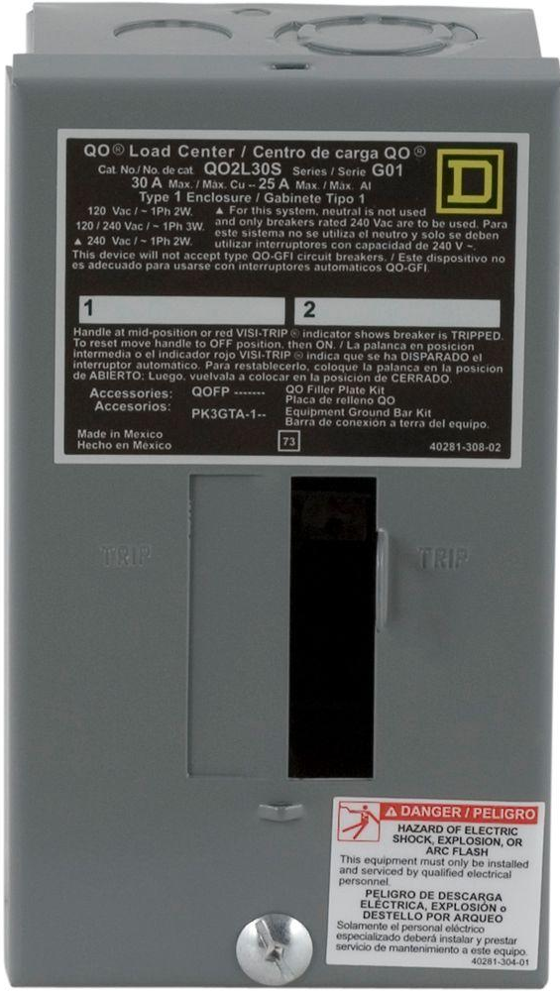
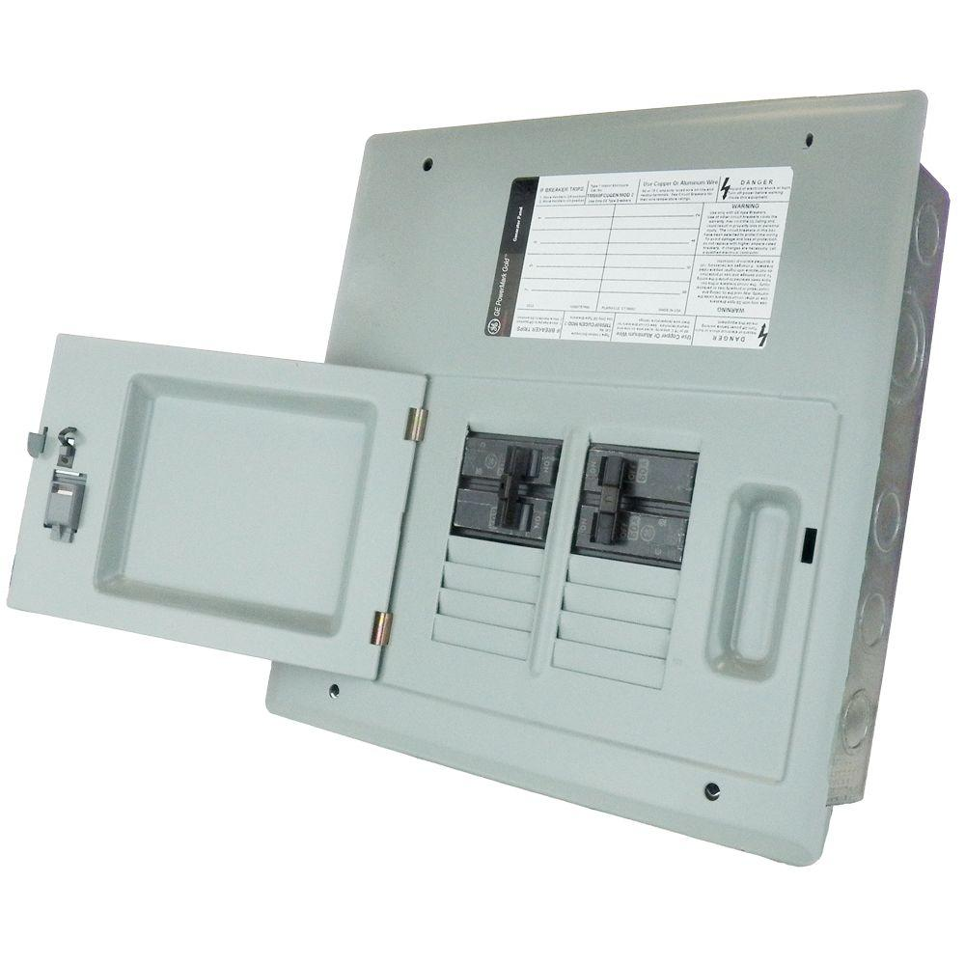
Fitting All the Appliances on Small Panels
Electrical Panel Sizes:
Small Trailer Home or Apartment | Apartment | Single Family Home
30 Amps | 50 Amps | 100-200 Amps

Slide 5
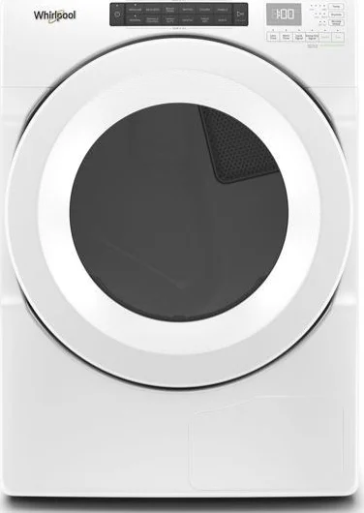
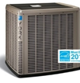
“Conventional” Efficient Appliances (240V)
Product Type | Electric Dryer-Energy Star | Heat Pump Water Heater | Split Heat Pump 2-4 Tons
Maximum Rating | 30A, 7,200W | 19A, 4,500W | 18-29 Amps, 4,300W-7,000W
Make and Model | Whirlpool WED5620HW | Rheem Prestige | York YZH060 Series
Image

Slide 6
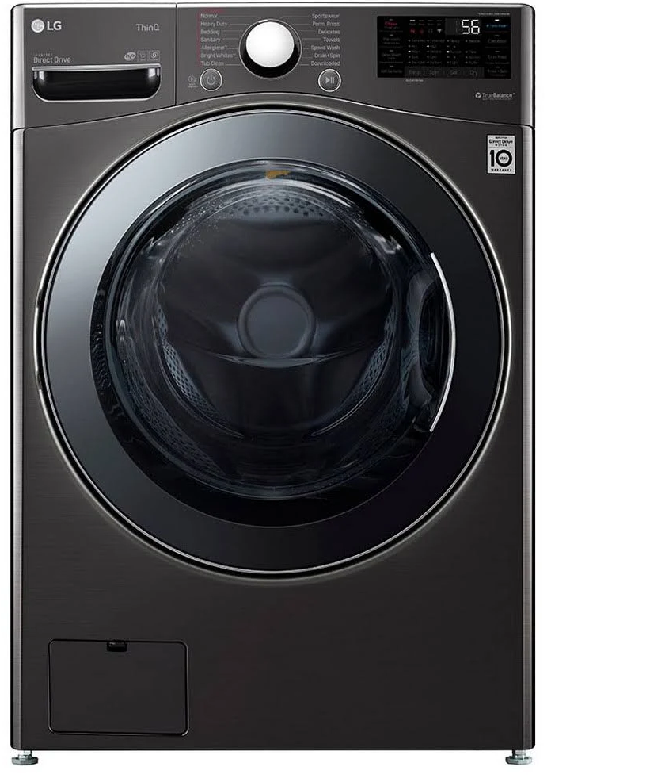
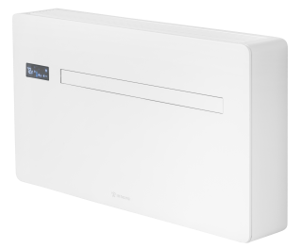
Power Efficient Appliances (120V)
Power at the panel is the limiting factor, but reducing appliance voltage can be another strategy
Product Type | 4.5 cu ft Condensing Washer/Dryer Combo | Heat Pump Water Heater | Low-Amp Window Heat Pump | 120V Mini-Split Heat Pump
Maximum Rating (Amps, Watts) | 10A, 1200W | 8.3A, 1000W | 6.3-15A, ~1400W | 10.4A, 1090W
Make and Model | LG WM3998HBA | GE GeoSpring | Innova HPAC 2.0 | LG LS-120HXV
Image

Slide 7
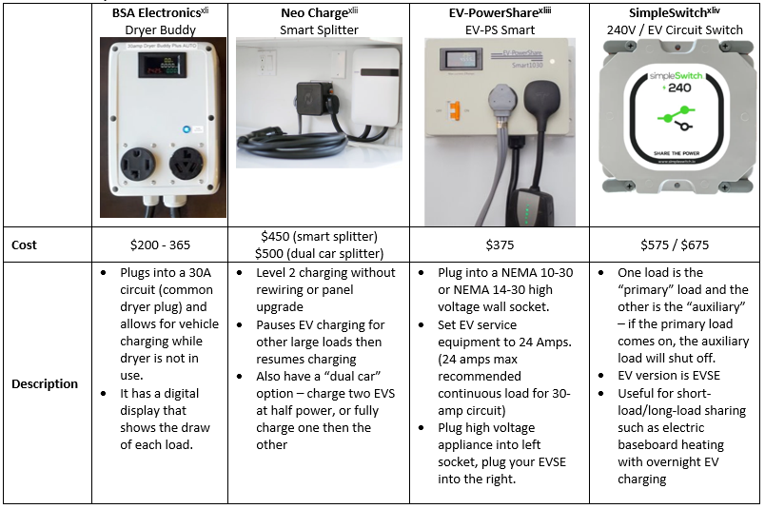
Smart Circuit Splitters and Sharing
For expanding capacity for EV charging and avoiding expensive charger installs
These are best used for non-EV appliances when one load is a short interruption of the other
For extremely small electrical panels, these will be crucial, especially 120V devices

Slide 8
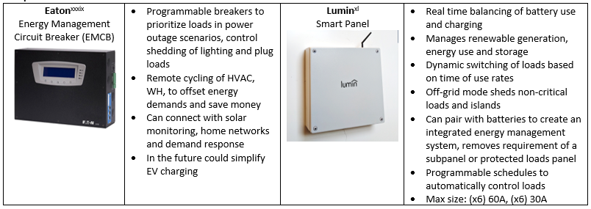
Programmable Subpanels
Sub Panels

Slide 9
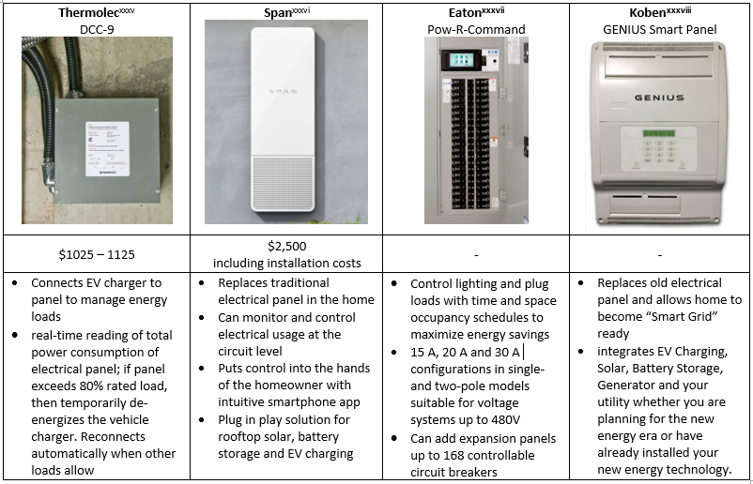
Programmable Panels
Whole House Panels
(some still in development, some with full energy management between loads)

Slide 10
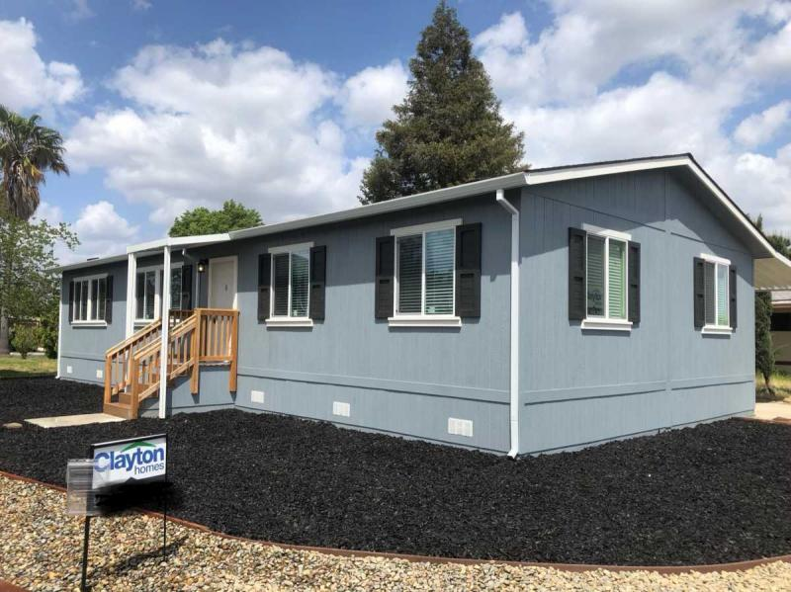
7200 Watt (30 Amp) Trailer Home Challenge
Sacramento Climate
Peak day is heating, low temp of 34F
Need to use all 120V products to save power at the panel
Need to use load-sharing devices similar to a NeoCharge or a Simple Switch, coming to market
Four circuits can fit on a 30-Amp panel

Slide 11
7200 Watt (30 Amp) Trailer Home Challenge
Can deliver 7,200 Watts of power to a 30-Amp panel: 240V x 30A = 7,200W
All 120V appliances, use SimpleSwitch or 120V NeoCharge to keep under 1,800W per circuit
Code requires 2 kitchen circuits, 20A Laundry, 20A Bathroom
1,100 square feet, delivers 21,000 BTUh on the coldest day
Kitchen Circuit 1 | Kitchen Circuit 2 | Laundry Circuit | Bathroom Circuit
Refrigerator 120-500W | Plug-in Induction Cooktop 1,500W | Condensing Washer 1,200W | 120V Heat Pump Water Heater 1,200W
Innova HPAC 1,400W | Innova HPAC 1,400W | (Innova HPAC 1,400W optional) |  | Total
1,800W Managed | 1,800W Managed | 1,800W | 1,800W | 7,200W

Slide 12
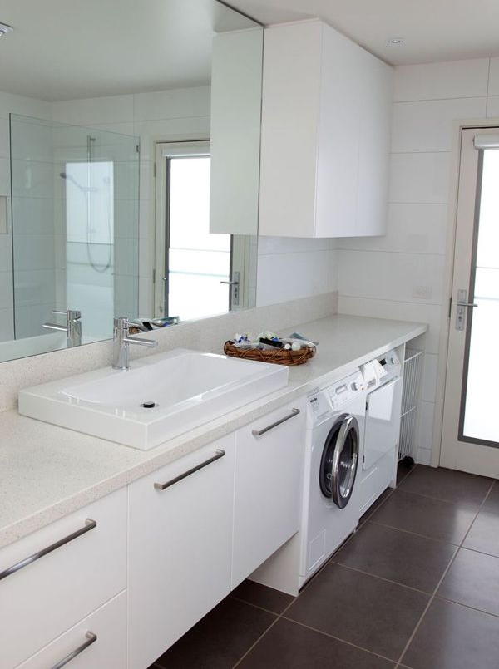
7200 Watt (30 Amp) Trailer Home Challenge
Placing the Laundry unit in the bathroom can save space and lighting
A maximum of 1,800W could be available for EVSE with a 120V NeoCharge style device if HVAC demand is low
120-Volt Mini Splits can replace Innova window units in the right applications for more amp savings

Slide 13
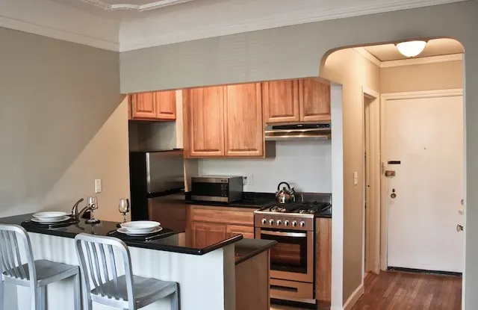
12,000 Watt (50-Amp) Apartment Challenge
Many existing apartments have a 50 Amp panel in each apartment, and are served with central Hot Water and Laundry.
We first examined 2-bedroom, 1,100 sq ft apartments in San Francisco early in our own Watt Diet journey

Slide 14
 |  |  | Code Circuits Required | 9.9 | kW
 |  |  | Required kW @ 100% |  | 4.00
Appliance with Dedicated Circuit |  |  | Required kW 40% | 5.9 | 2.36
 | # of devices | Volts | Amps | Design Rated Watts
Fridge | 1 | 110 | 0.91 | 100 | 0.04
Disposal | 1 | 120 | 3 | 311 | 0.12
Overhead Microwave | 1 | 120 | 5 | 600 | 0.24
Built in Oven | 1 | 240 | 24 | 5760 | 2.30
Induction 2 Burner | 1 | 120 | 15 | 1800 | 0.72
120 V HP WH | 1 | 120 | 8.3 | 996 | 0.40
HP chosen | 1 | 240 | 12 | 1,430 | 1.43
 |  |  |  | Total Panel power (kW) | 11.62
 |  |  |  | Total Amps at 240V | 48.4
 |  |  |  | Minimum Panel Size | 50 A panel
50-Amp San Francisco Apartment Unit

Slide 15
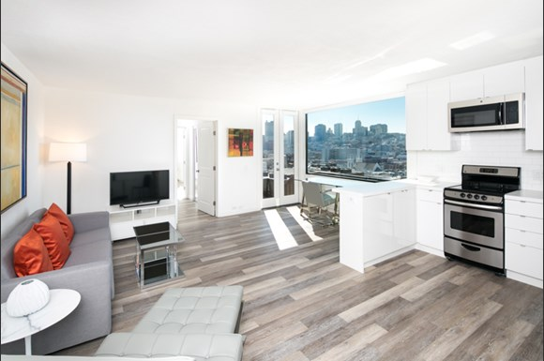
12,000 Watt (50-Amp) Apartment Challenge
These large two-bedroom units meet the appliance expectations of savvy apartment tenants
We found that central water and laundry systems help avoid panel upgrades
Keeping power use low is especially important in cities with impacted transformer sizing from utilities

Slide 16
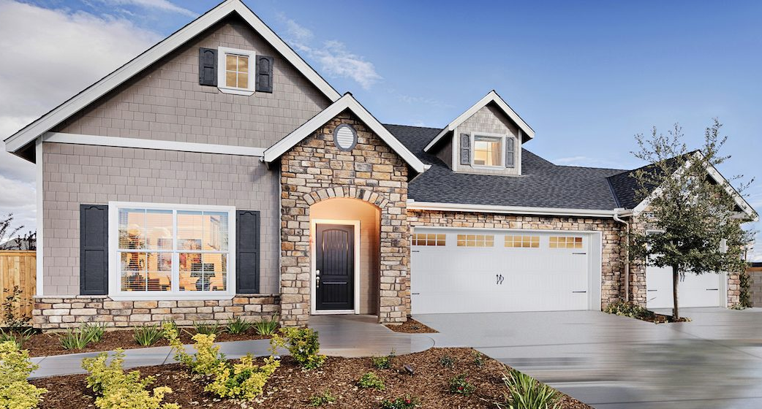
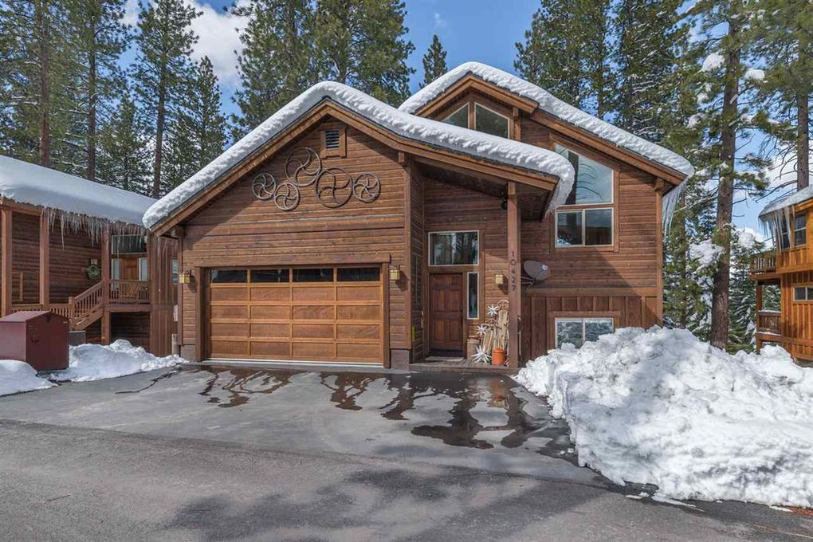
2000 Square Foot Single Family Homes - From Bakersfield to Truckee

Slide 17
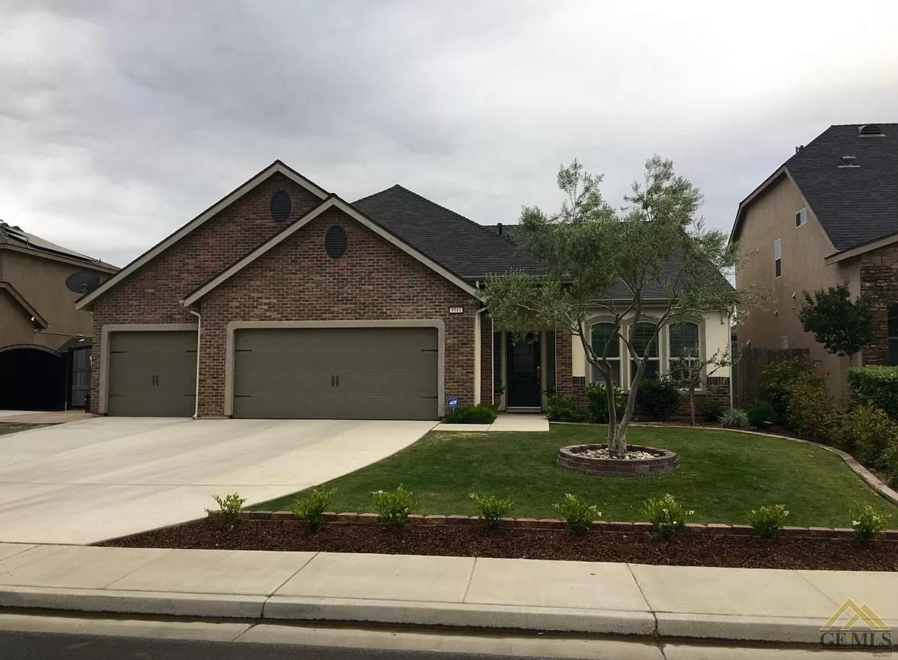
24,000 Watt (100-Amp) Home - Bakersfield
2,000 square feet
It turns out that many warm CA climates can still live large on 100 Amps
High efficiency condensing washers and the 120V GeoSpring HPWH were chosen to allow for more fun electric appliances
A ton of extra room on the panel beyond the necessities

Slide 18
Bakersfield Single Family Load Calculations
 |  |  | Subtotal from Code Required Circuits | 12.6 | Panel kW
 |  |  | Required kW @ 100% |  | 8.00
Appliance with Dedicated Circuit |  |  | Required kW at 40% | 4.6 | 1.84
 | # of devices | Volts | Label Amps | Watts
Fridge | 1 | 120 | 3.5 | 420 | 0.17
Chest Freezer | 1 | 120 | 3 | 360 | 0.14
Disposal | 1 | 120 | 3 | 310.5225 | 0.12
Dishwasher | 1 | 120 | 10 | 1200 | 0.48
Pool | 1 | 230 | 12 | 2760 | 1.10
Lawn Sprinklers | 1 | 120 | 15 | 1800 | 0.72
Hot Tub | 1 | 120 | 15 | 1800 | 0.72
Fireplaces | 1 | 120 | 15 | 1800 | 0.72
Combi Microwave | 1 | 120 | 7 | 840 | 0.34
Range (cooktop on oven) | 1 | 240 | 40 | 9600 | 3.84
Combined Wash/Dryer | 1 | 120 | 10 | 1200 | -
120 V HP WH | 1 | 120 | 8.3 |  | 0.40
HP SC 2 tons | 1 | 120 | 12 | 4,400 | 4.40
EVSE 40 Amp | 1 | 240 | 40 |  | 4.80
EVSE Charge Pauser | 1 | 240 | -40 |  | - 4.80
 |  |  |  | Total Panel kW | 23.70
 |  |  |  | Total Amps | 98.7
 |  |  |  | Minimum Panel size required | 100 A panel

Slide 19
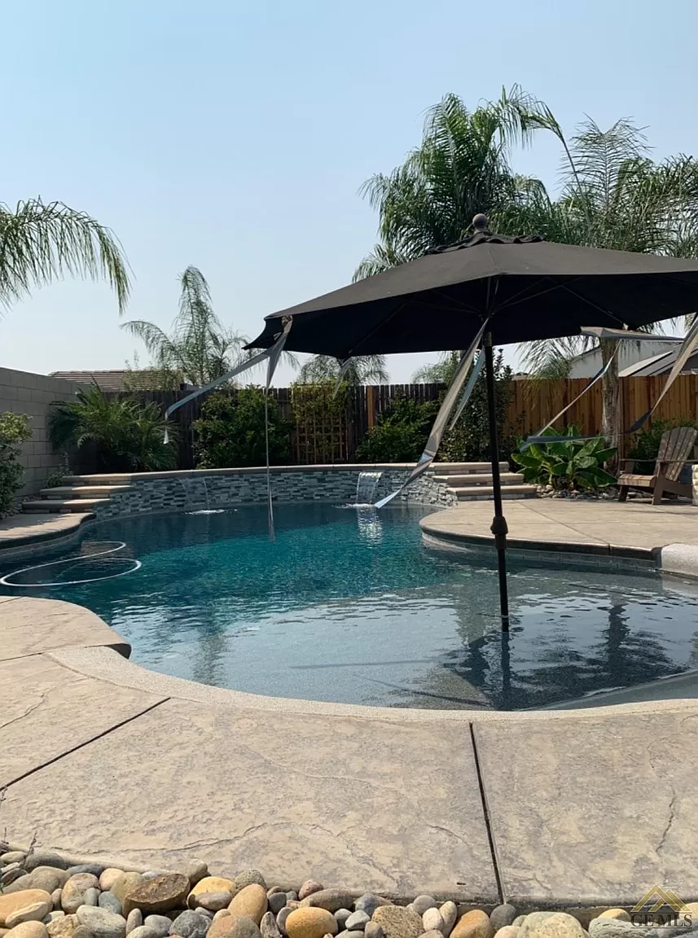
24,000 Watt (100-Amp) Home - Bakersfield
Winter heating was the peak load, because of dry CA summers
Want to have a winter pool party? We included a pool heat pump, two refrigerators, a small hot tub, and an electric fireplace!
Ample opportunities to save power with an all-electric home and a 100-amp panel, many homes may not have all these amenities

Slide 20
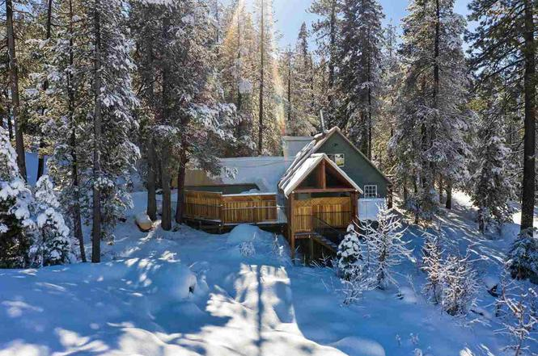
100-Amp Home - Truckee
Temperatures down to 7 Degrees Fahrenheit
1450 Square feet
Peak Heating Load similar to Long Island, NY
Nearly ⅓ of power going to ductless heating on Peak Day
Uses a 240V HPWH, could go down to 120V for power savings

Slide 21
Truckee Single Family Load Calculations
 |  |  |  | Subtotal from Code Required Circuits | 10.8 | Panel kW
 |  |  |  | Required kW @ 100% Coinc. |  | 8.00
Appliance with Dedicated Circuit | Coincidence Factor |  |  | Required kW portion at 40% coincidence | 2.8 | 1.12
 |  | # of devices | Volts | Label Amps | Watts
Fridge | 0.4 | 1 | 120 | 3 | 360 | 0.14
Disposal | 0.4 | 1 | 120 | 2.6 | 311 | 0.12
Dishwasher | 0.4 | 1 | 120 | 10 | 1,200 | 0.48
Grill | 0.4 | 1 | 120 | 14.6 | 1,750 | 0.70
Hot Tub | 0.4 | 1 | 120 | 15 | 1,800 | 0.72
Fireplaces | 0.4 | 1 | 120 | 12.5 | 1,500 | 0.60
Range (cooktop on oven) | 0.4 | 1 | 240 | 40 | 9,600 | 3.84
HP only WH | 0.4 | 1 | 240 | 13 | 3,120 | 1.25
Heat Pump Selected | 1 | 1 | 240 | 29.2 | 7,000 | 7.00
EVSE 40 Amp | 0.5 | 1 | 240 | 40 | 9,600 | 4.80
Charge Pauser |  | 1 | 240 | -40 | -9,600 | - 4.80
 |  |  |  |  | Total Power (kW) | 23.98
 |  |  |  |  | Total Amps | 99.9
 |  |  |  |  | Minimum Panel size required | 100 A panel

Slide 22
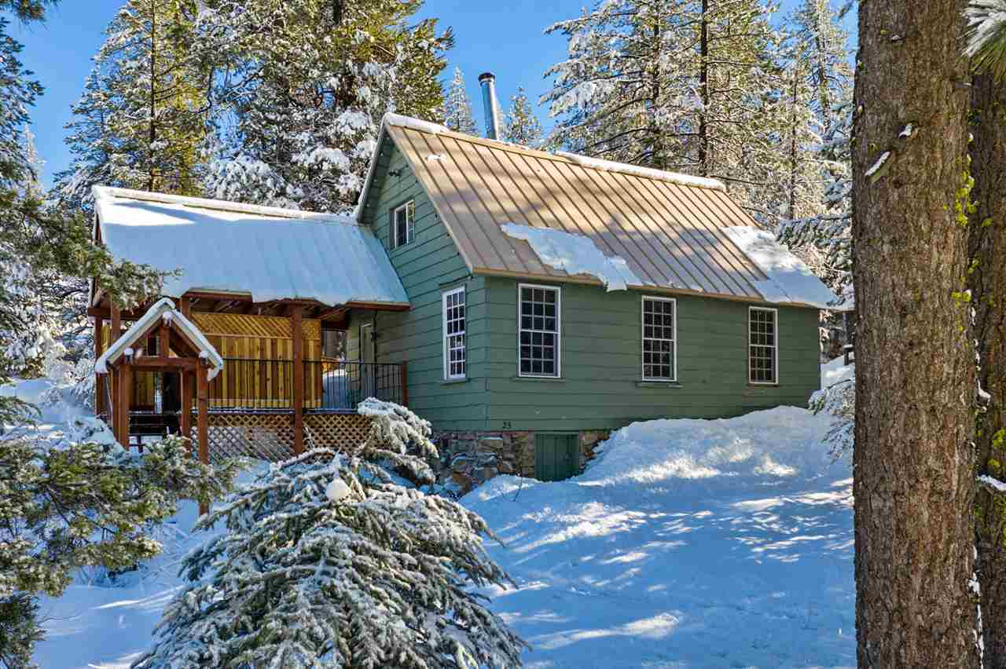
24,000 Watt (100-Amp) Home - Truckee
Goal was to provide more stuff while meeting HVAC
You could take off things like Fireplace, Hot Tub, Grill, etc for more spare capacity
Can use the required laundry circuit to charge EV with NeoCharge device
Cold climate retrofits are possible even without panel upgrades!

Slide 23
The Watt Diet Calculator
Developed by Tom Kabat and edited by Redwood Energy
Follows the California electrical code requirements
General methodology:
Calculates building heating load based on building characteristics and location
Calculates the total watt diet of the home
Converts total watts to panel amps
From there you can determine your needed panel size
Allows pinpointing of appliances that are electricity guzzlers
Integrates EVSE and load management with your whole house

Slide 24
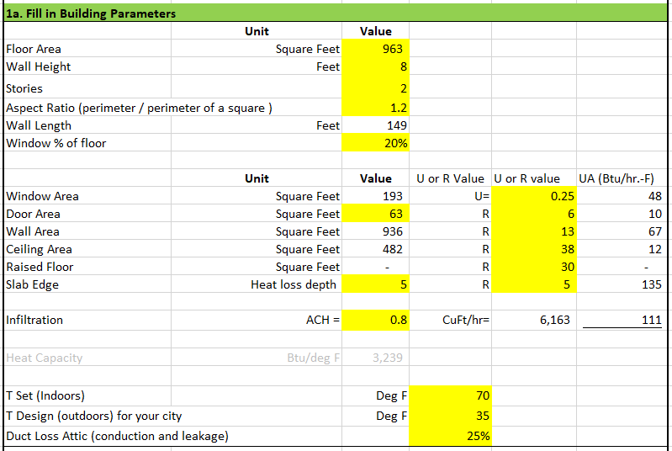
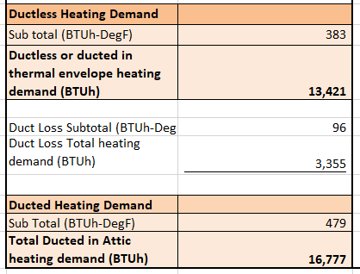
Step 1: Heating Load Estimate
Enter building parameters and design temperatures
Result is the heating load in BTUh with and without ducts:

Slide 25
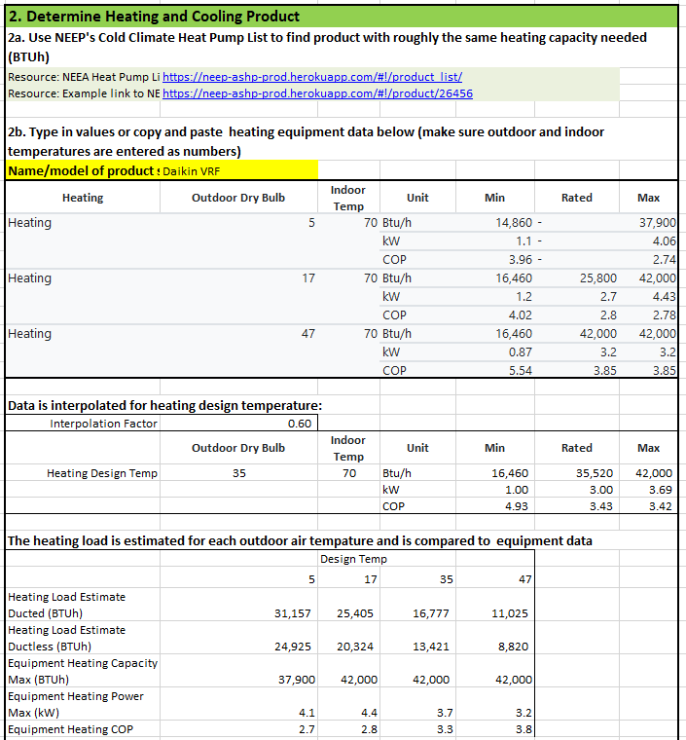
Step 2: Determine your heating and cooling product
Enter product specs that roughly match your heating load
The heating capacity and power are interpolated to the specified design day
This gives us an idea how much power will be used for heating

Slide 26
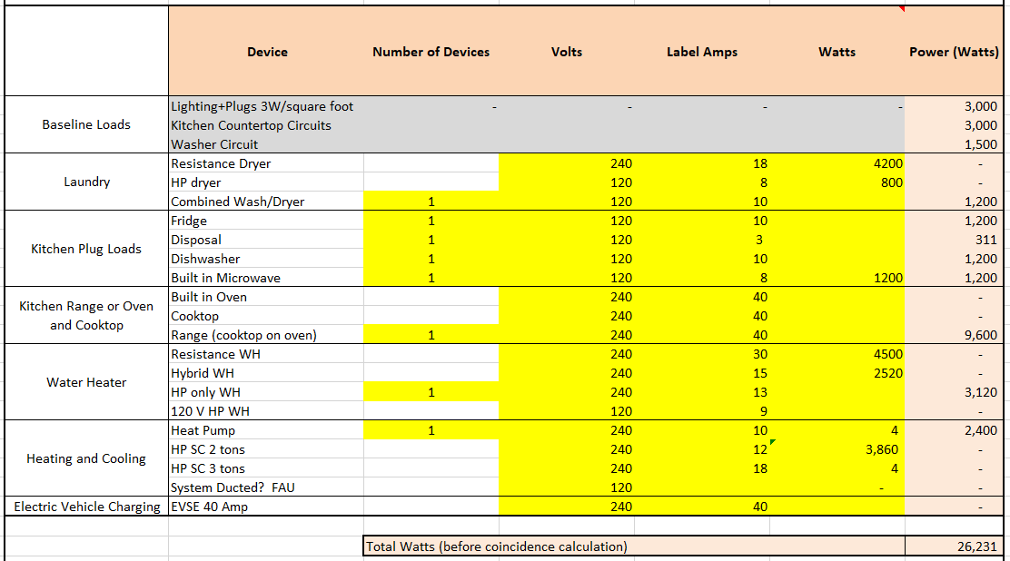
Step 3: Calculated total device watts
Enter in number of devices
Enter in either volt and amps or watts for each device
Total device watts are calculated

Slide 27
Step 3: Whole total panel watts
Panel watts are calculated by multiplying device watts by a coincidence factor
The first 8,000 watts are 100% coincidence, the remaining watts are 40%
Heat pumps are 100% coincidence
Heat pump water heaters are 40% coincidence
EV charging is 50% coincidence

Slide 28
Questions?

